Slide 1



MovieDome
An easy way to get recommended movies…

Slide 2
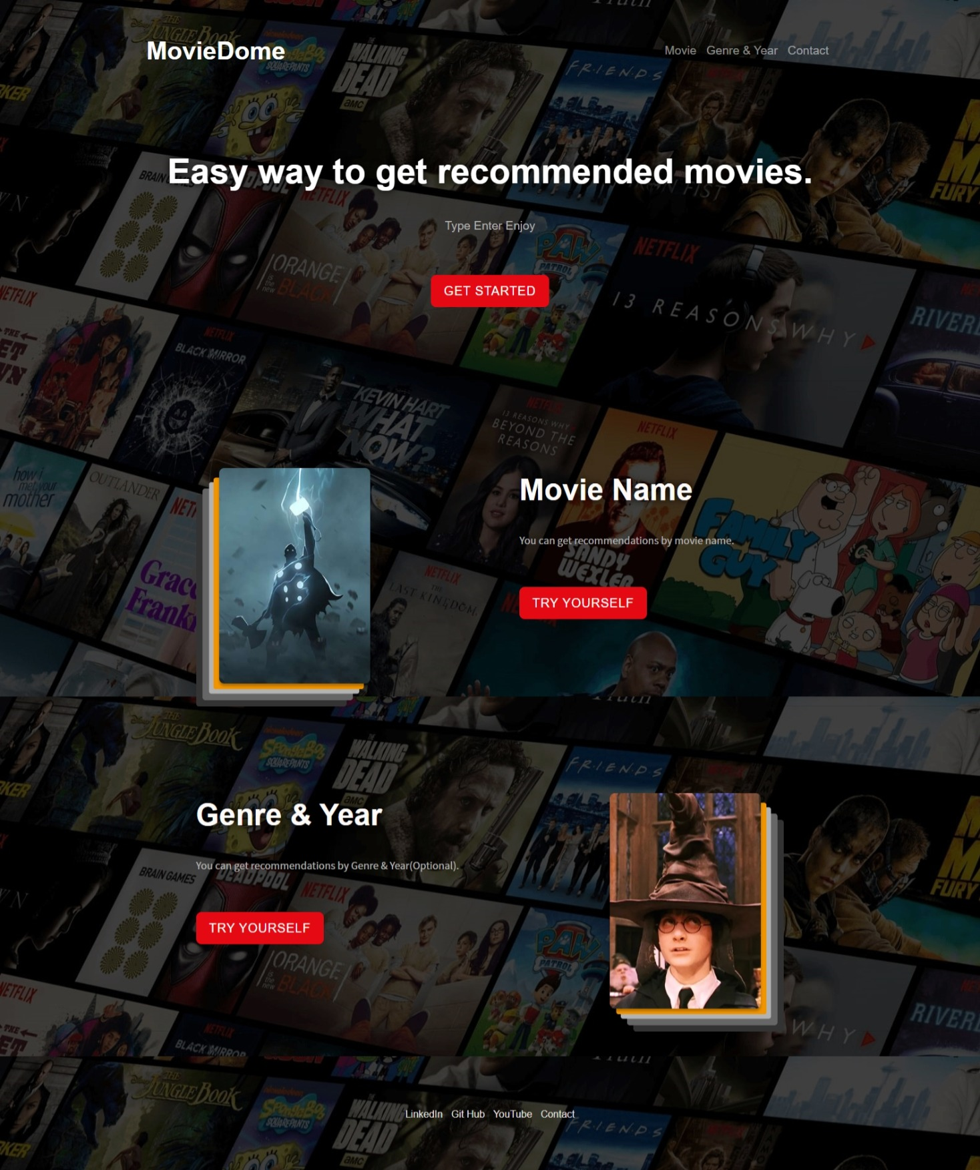
Objectives
Movie recommendation system created using collaborative filtering in website and content based filtering in ML algorithm such as K nearest neighbors. You can get recommended movies by movie name or genre.
It apply sentiment analysis to categorize user comments on a particular movie.

Slide 3
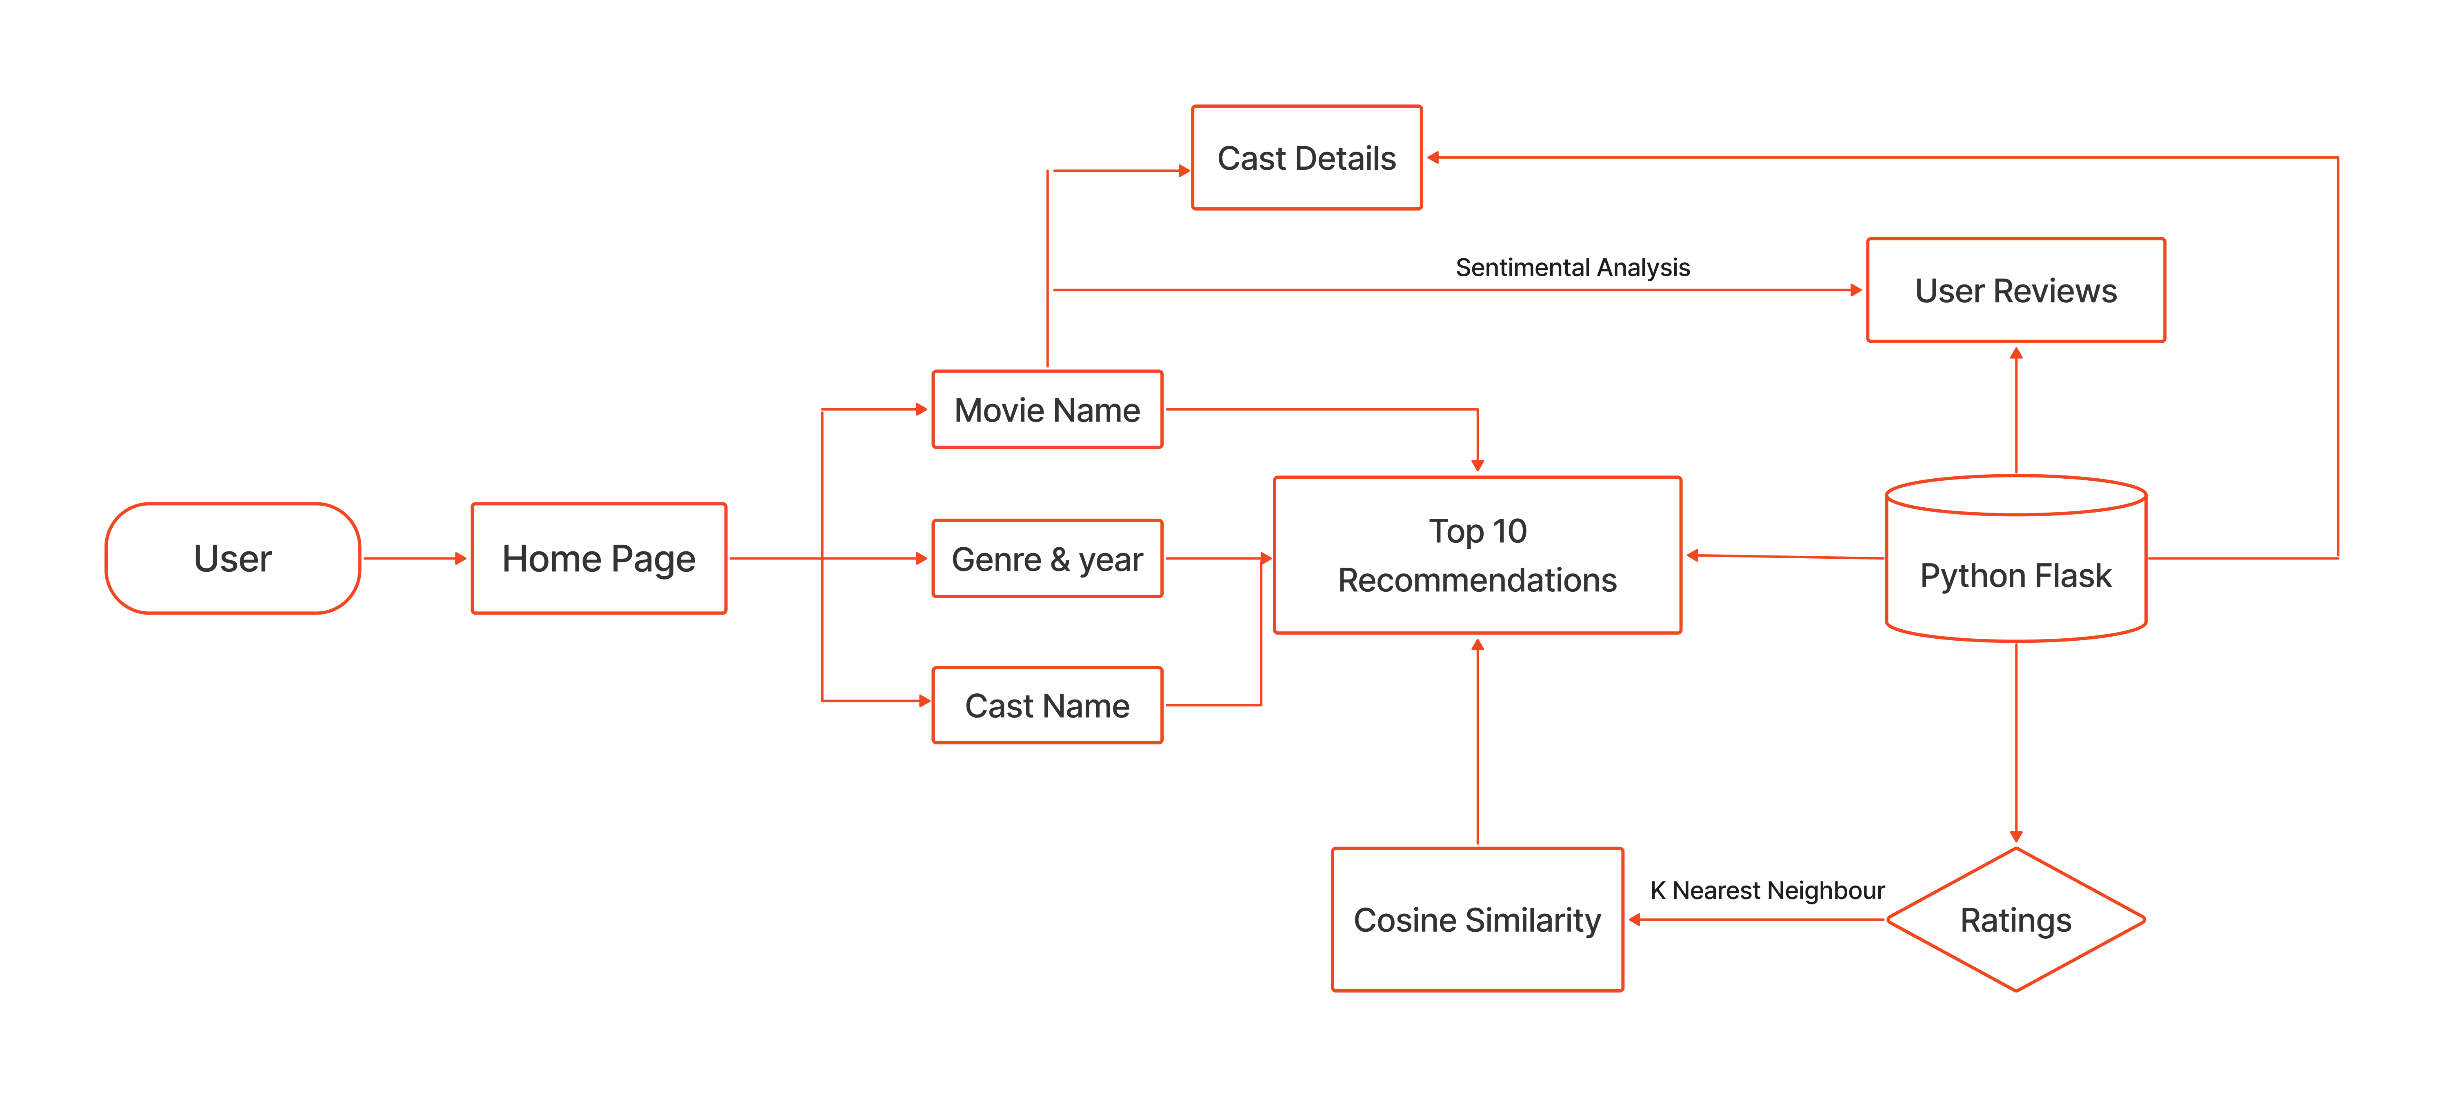
FLOWCHART

Slide 4
Content-based Filtering
This algorithm is recommending stuff based on attributes of the item. For example, recommending movies based on their genres and released year. If we have genres like romance, comedy, action, drama, and horror for a movie and user liked that movie, it is good to recommend the movies with the same genres.

Slide 5
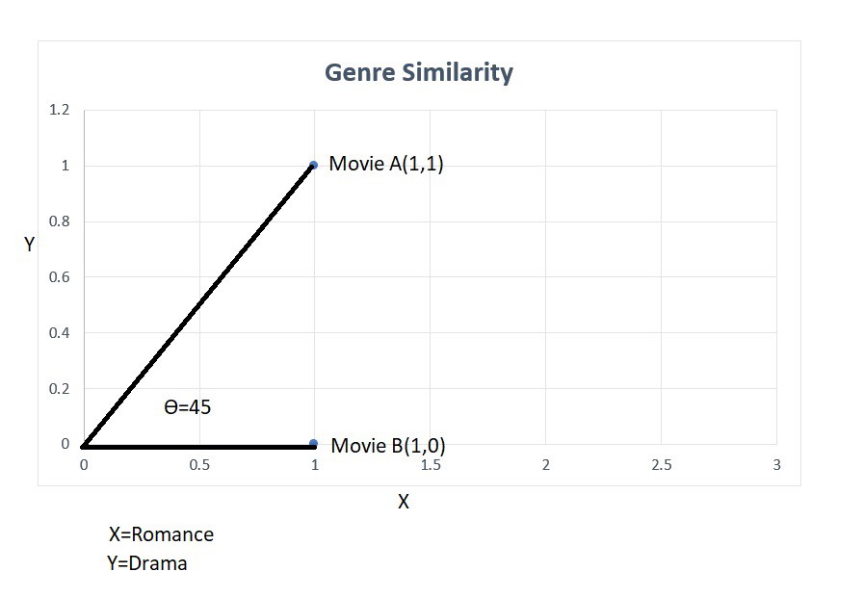
Cosine Similarity
If a movie A has romance and drama as it’s genres. Movie B has romance only as it’s genre. When we draw a 2D graph for the genres, we have to consider the romance as x-axis and drama as the y-axis. If we give value one for a genre the movie A will have the coordinate of (1,1) in the graph and movie B will have the coordinate of (1,0).

Slide 6
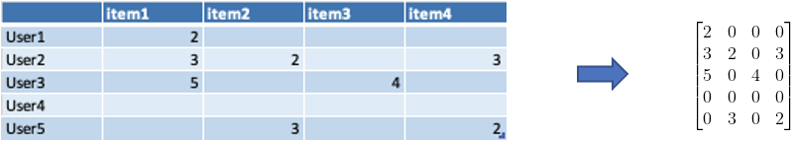
User-based Collaborative Filtering
Finding other users similar to yourself based on their rating history and recommending movies that you haven’t watched. It’s recommending movies on other user’s collaborative behaviors. That’s why it is called user-based collaborative filtering.

Slide 7
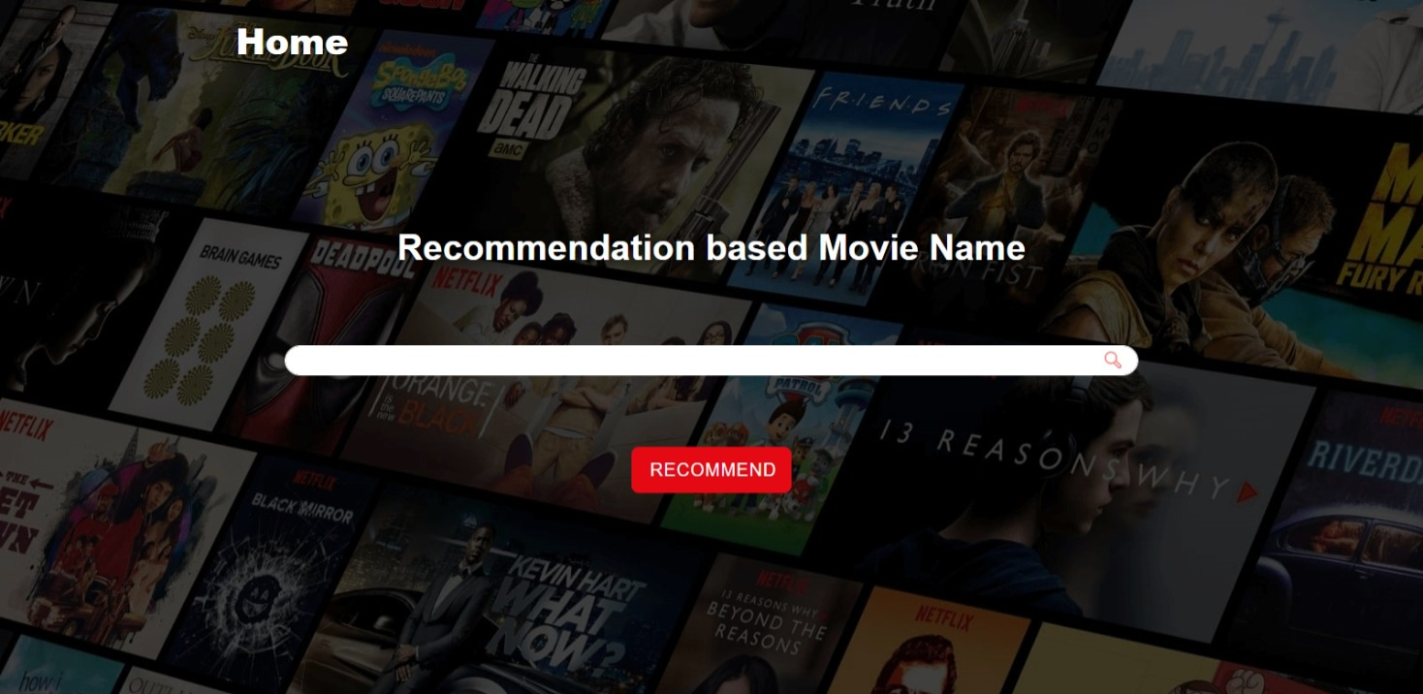

Slide 8
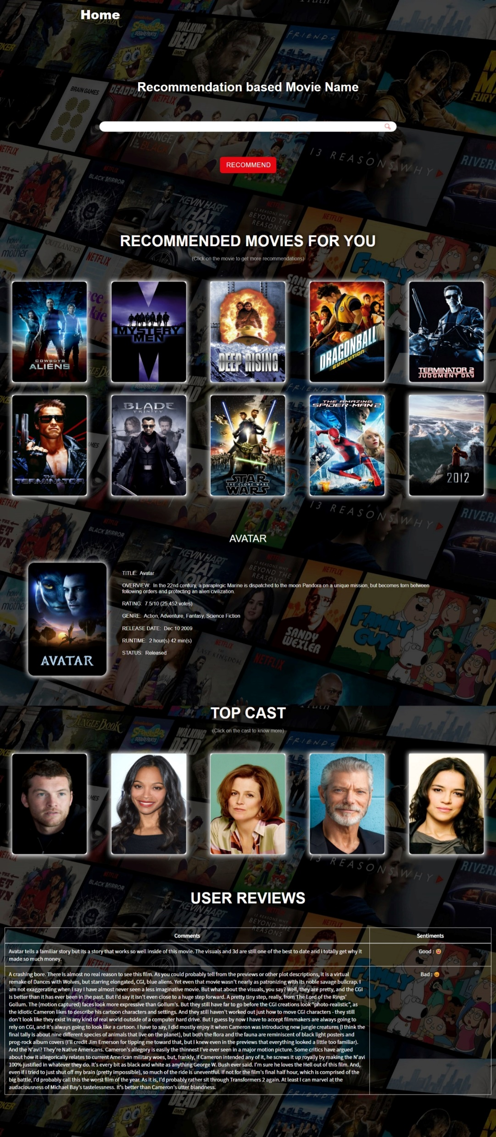
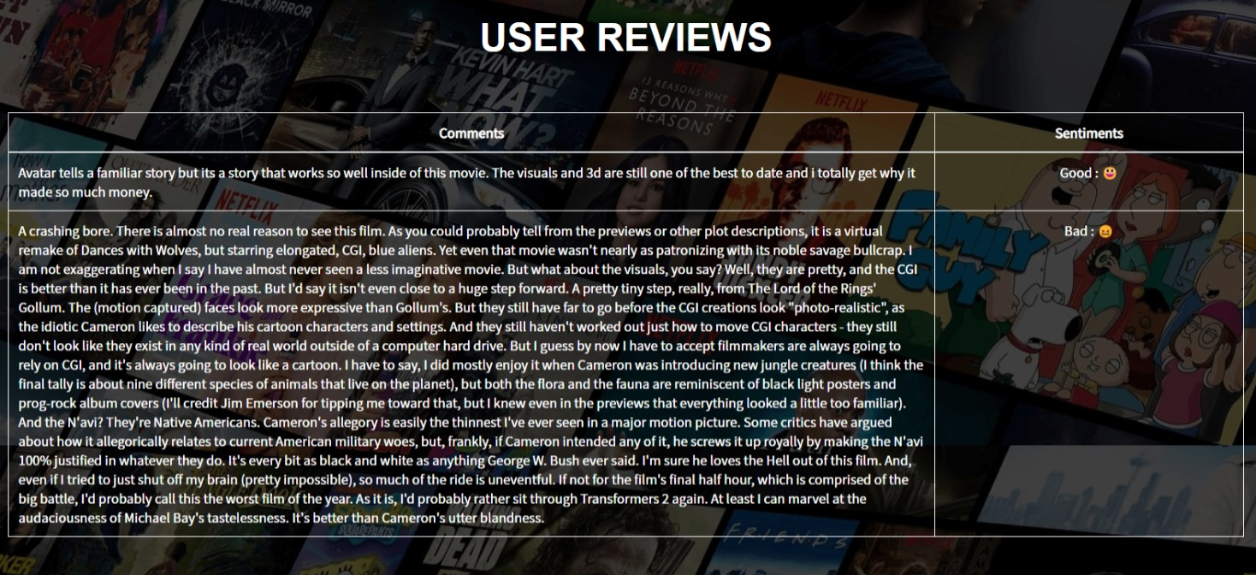

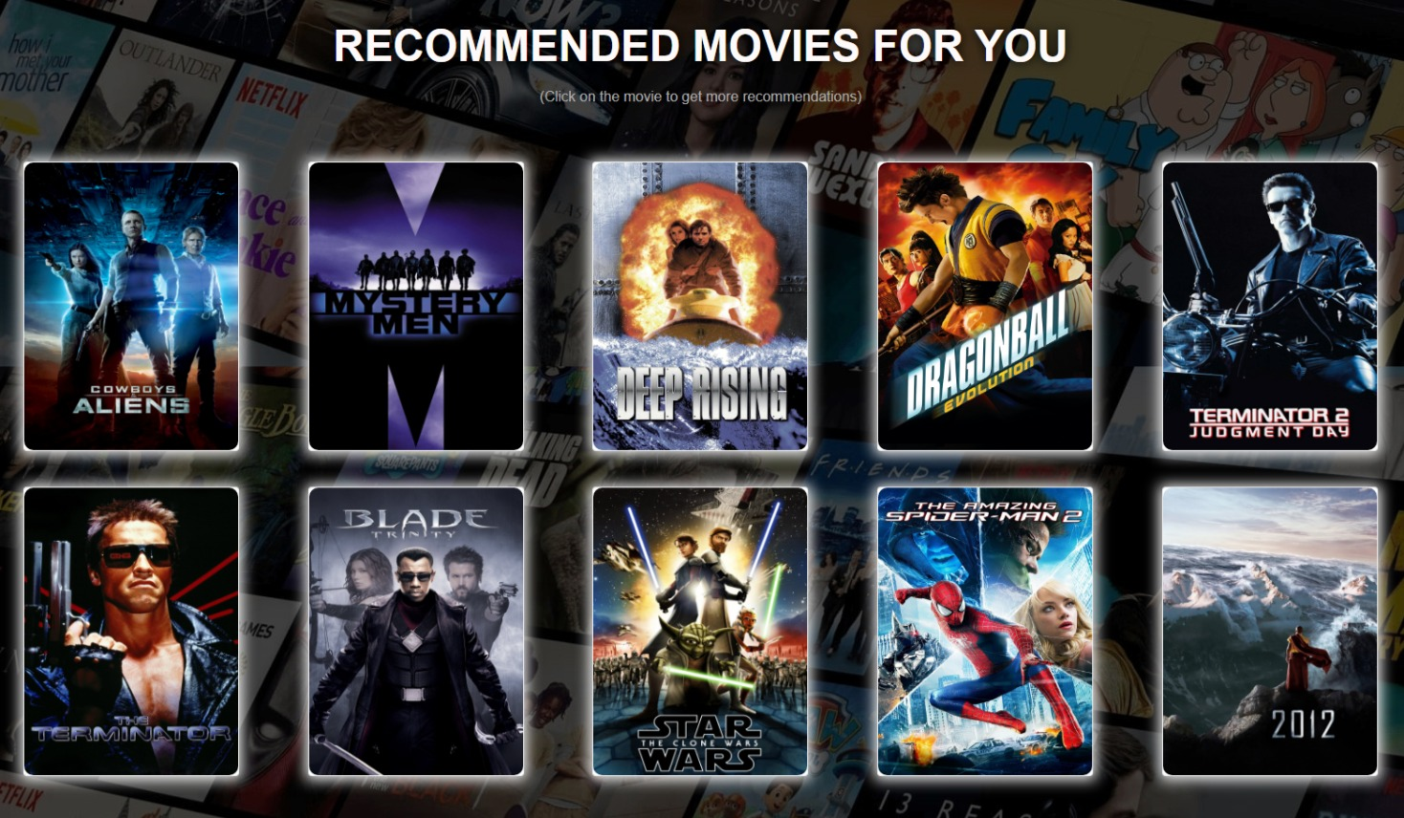
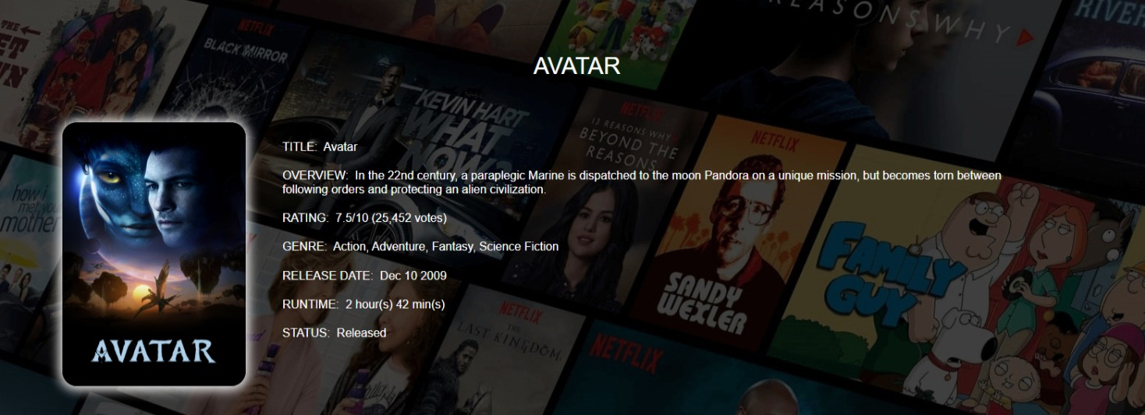

Slide 9
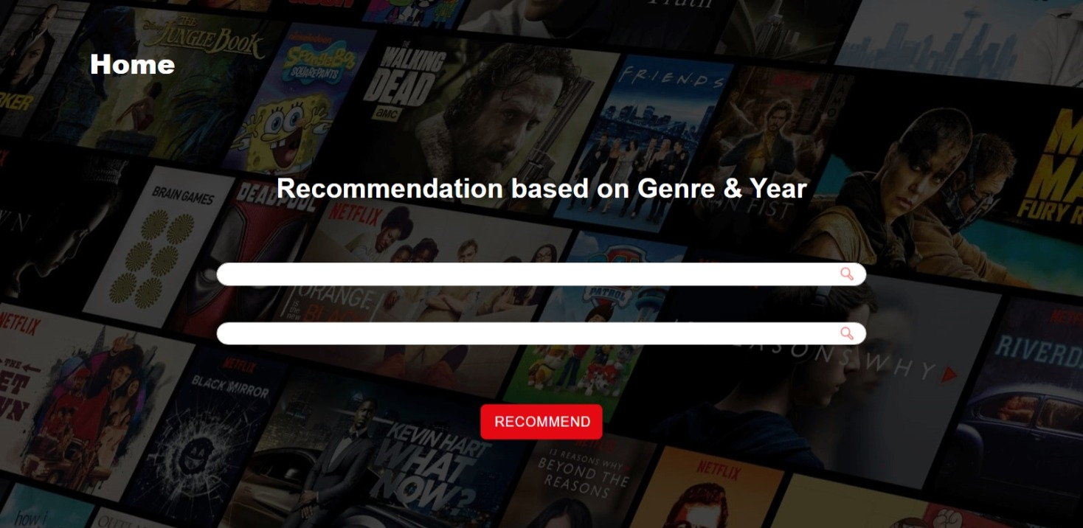

Slide 10
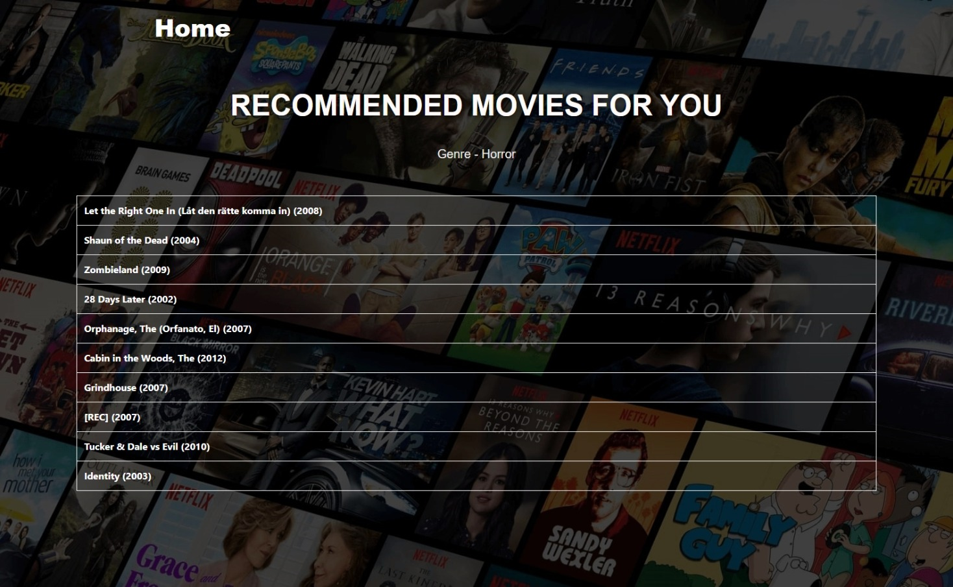

Slide 11
MovieDome signing off!!

